Slide 1
Digital Portfolio
STUDENT NAME: T.V.Srihari
REGISTER NO:212402434
NMID: asunm1301212402434
DEPARTMENT: BCA
COLLEGE: COLLEGE/ UNIVERSITY: A.M.Jain college/Madras university

Slide 2
STUDENT ’ s PORTFOLIO

Slide 3


AGENDA
Problem Statement
Project Overview
End Users
Tools and Technologies
Portfolio design and Layout
Features and Functionality
Results and Screenshots
Conclusion
Github Link
3/21/2024 Annual Review

Slide 4

PROBLEM STATEMENT
In today’s digital era, having a personal portfolio is essential for students and professionals. A well-designed portfolio showcases skills, achievements, and certifications in a single platform. The problem is that resumes are static and cannot display interactive features such as project previews, certificates, or direct contact options. Hence, a digital portfolio provides an engaging and professional way to present oneself.

Slide 5

PROJECT OVERVIEW
This project is a personal portfolio website developed using HTML, CSS, and JavaScript. The portfolio introduces me, displays my academic achievements, certificates, education background, and provides direct communication through a contact form. The design is made visually appealing with background GIF animations, smooth navigation, and interactive certificate pop-ups.

Slide 6

WHO ARE THE END USERS?
Students & Recruiters – to check my achievements and skills.
Faculty/Examiners – to evaluate my project and design skills.
Peers & Connections – to get inspired and collaborate.
General Audience – anyone who wishes to learn about me or contact me.

Slide 7

TOOLS AND TECHNIQUES
HTML → for webpage structure.
CSS → for styling, layout, and animations.
JavaScript → for interactivity (certificate popup, navigation).
Browser & Code Editor → Chrome, VS Code.

Slide 8
Portfolio Design and Layout
The portfolio is divided into clear sections with a navigation bar:
Home / About Me → Profile picture, introduction, and short bio.
Education → My academic background and course details.
Certificates → Clickable images of certificates with popup view.
Contact → Email form for visitors to reach me.

Slide 9
FEATURES AND FUNCTIONALITY
✅ Responsive design for desktop and mobile. ✅ Navigation bar with smooth scrolling. ✅ Profile picture and About Me section. ✅ Certificates with click-to-enlarge popup. ✅ Contact form with email integration.

Slide 10
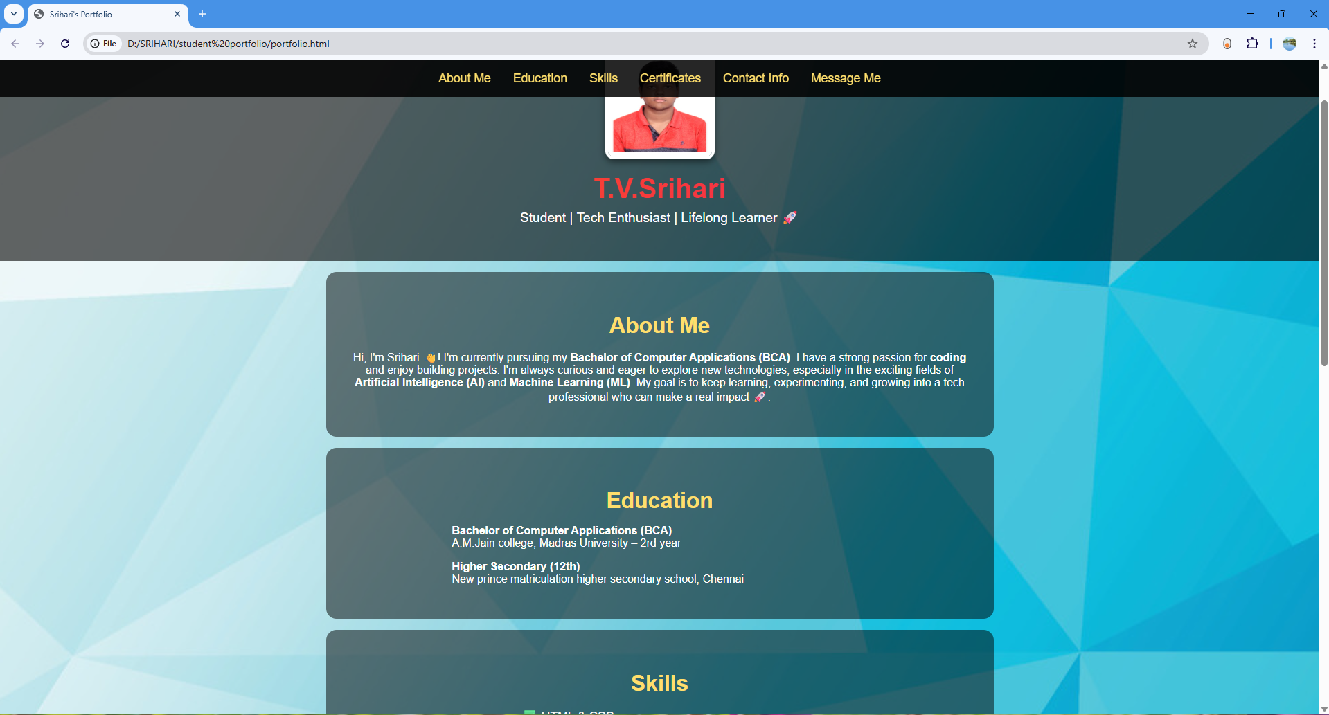
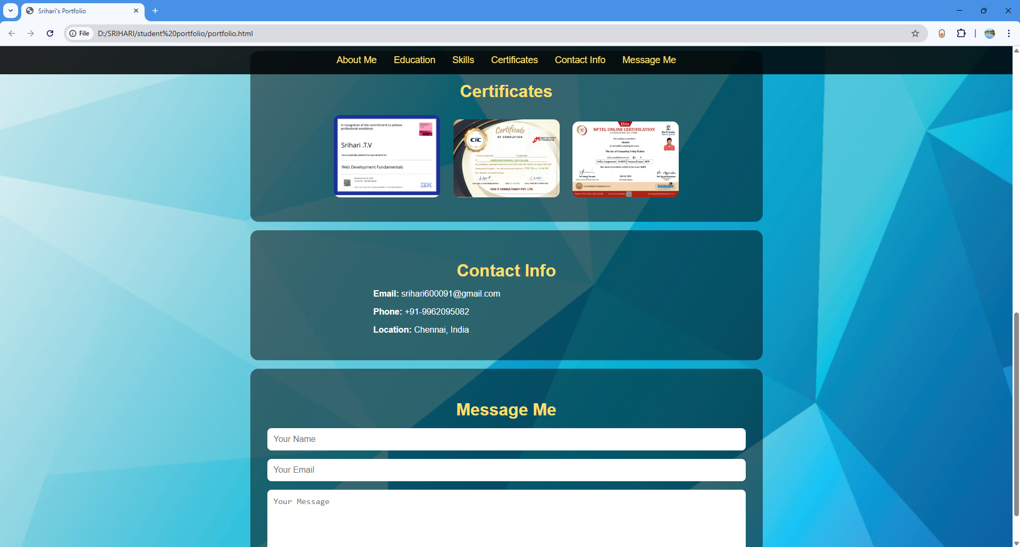

RESULTS AND SCREENSHOTS
3/21/2024 Annual Review
10

Slide 11
GITHUB LINKS
Github repo link: https://github.com/sriharitv2007/TNSDC-FWD-Digitalportfolio.git
Github portfolio code link: https://github.com/sriharitv2007/TNSDC-FWD-Digitalportfolio/blob/3788908dbb83fa2146f75b2f4b7f28161d691e15/portfolio.html
My portfolio link: https://sriharitv2007.github.io/TNSDC-FWD-Digitalportfolio/

Slide 12
CONCLUSION
This project demonstrates the importance of personal branding through a digital portfolio. It highlights my technical knowledge in web development and showcases my academic progress and certifications. The project can be further improved by hosting it online, adding more projects, and integrating AI/ML learning journeys in the future.
12

